Slide 1
STS-2025 Antenna Guide for Rail Applications
LILEE Systems
2023/7/20

Slide 2
5G + WiFi + GNSS
 | Antenna Arrangement | Vendor | Vendor Model | Quantity | Note
A | Space-Saving | Huber+Suhner | 1399.99.0133 | 1 | Cellular ports max gain: 6 dBi WiFi ports max gain: 7 dBi
B | Distributed | Huber+Suhner | 1399.13.0130 | 5 | Cellular ports max gain: 7.5 dBi, 5 ~ 6 dBi in sub-GHz bands WiFi ports max gain: 7.5 dBi

Slide 3
5G + GNSS
 | Antenna Arrangement | Vendor | Vendor Model | Quantity | Note
A | Space-Saving | Huber+Suhner | 1399.99.0133 | 1 | Cellular ports max gain: 6 dBi WiFi ports max gain: 7 dBi
B | Distributed | Huber+Suhner | 1399.13.0130 | 4 | Cellular ports max gain: 7.5 dBi, 5 ~ 6 dBi in sub-GHz bands WiFi ports max gain: 7.5 dBi

Slide 4
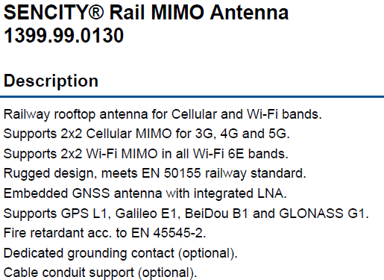
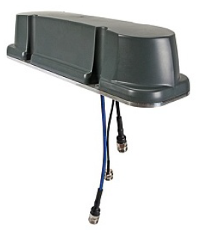
Recommended Antenna – 1399.99.0130 3-port

Slide 5
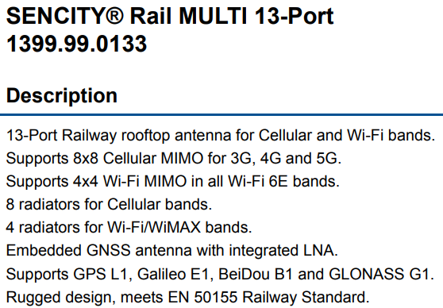
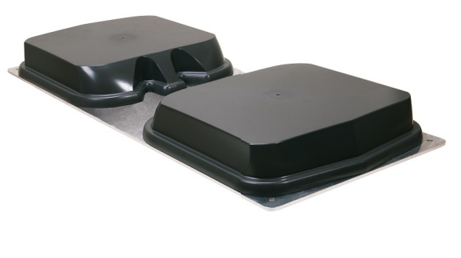
Recommended Antenna – 1399.99.0133 13-port

Slide 6
Mounting of Antenna
Select proper location(s) on top of the locomotive, number and label the locations. Example numbering used in this document:
  Location 0 ~ 3 for cellular (5G) and GNSS use
  Location 4 for WiFi use
Follow OEM mounting instruction to secure the antenna to selected location(s)
  Mounting instruction of Huber+Suhner 1399.99.0130:
  Mounting instruction of Huber+Suhner 1399.99.0133:
Number and label antenna according to their respective installed location(s).
  Example: antenna 0 corresponds to location 0, antenna 1 to location 1, so on and so forth

Slide 7
Connecting Antenna to STS-2025 – 1399.99.0130
Cables Needed:
  8 * N plug (male) to SMA plug (male), length proper for distances between antenna and STS-2025
  2 * N plug (male) to RP-SMA plug (male), length proper for distances between antenna and STS-2025
  1 * TNC jack (female) to SMA plug (male), length proper for distances between antenna and STS-2025

Slide 8
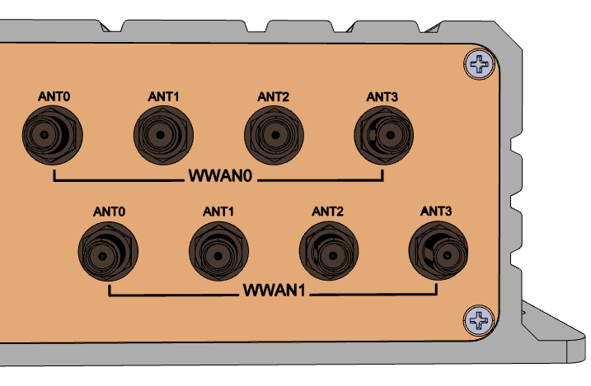
Connecting Antenna to STS-2025 – 1399.99.0130
Steps for cellular connection
  For antenna 0 ~ 3, take 2 a) cables for each antenna and connect N plug of each cable to one of the N jacks of the antenna.
  Note: each antenna has 2 N jacks, each of the N jacks needs one a) cable
  For each of cables in step 1., connect its SMA plug to one of STS-2025’s WWAN ANTn ports.
  It is recommended that the two cables from antenna are
  connected to STS-2025 in order and in pair.
  For example:
  Antenna 0 are connected to WWAN0’s ANT0 and ANT1
  Antenna 1 are connected to WWAN0’s ANT2 and ANT3
  Antenna 2 are connected to WWAN1’s ANT0 and ANT1
  Antenna 3 are connected to WWAN1’s ANT2 and ANT3

Slide 9
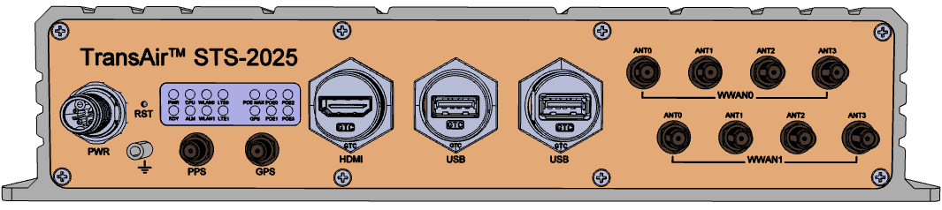
Connecting Antenna to STS-2025 – 1399.99.0130
Steps for GNSS connection (skip if GNSS is not needed)
  For antenna 0, connect TNC plug of antenna 0 to TNC jack of cable c)
  For the cable in step 1., connect its SMA plug to STS-2025’s GPS port.

Slide 10
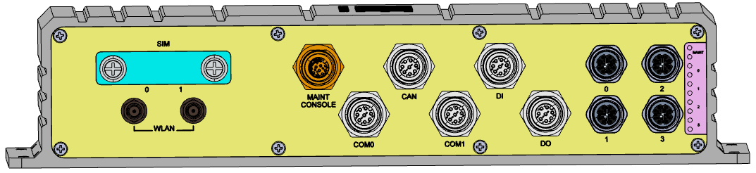
Connecting Antenna to STS-2025 – 1399.99.0130
Steps for WiFi connection (skip if WIFI is not needed)
  For antenna 4, take 2 b) cables and connect N plug of each cable to one of N jacks of the antenna 4.
  Note: antenna 4 has 2 N jacks, each of the N jacks needs one b) cable
  For each of the cables in step 1., connect its RP-SMA plug to one of STS-2025’s WLAN ports.

Slide 11
Connecting Antenna to STS-2025 – 1399.99.0133
Cables Needed:
  8 * N plug (male) to SMA plug (male), length proper for distances between antenna and STS-2025
  2 * N plug (male) to RP-SMA plug (male), length proper for distances between antenna and STS-2025
  1 * TNC jack (female) to SMA plug (male), length proper for distances between antenna and STS-2025

Slide 12
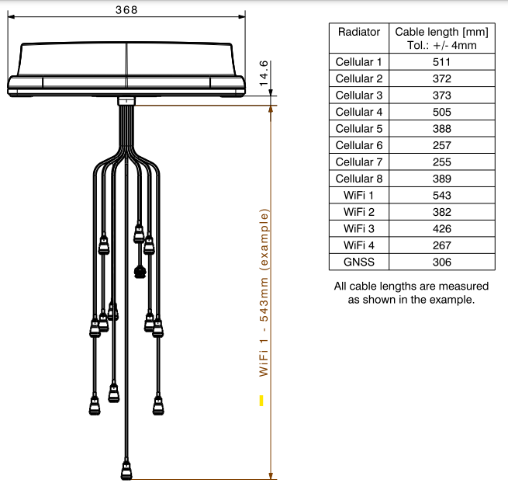
Connecting Antenna to STS-2025 – 1399.99.0133
Identifying connectors:
  Please identify and label the connectors for each type of the radiators according to the drawing

Slide 13
Connecting Antenna to STS-2025 – 1399.99.0133
Steps for cellular connection
  Take 8 a) cables and connect N plug of each cable to one of the N jacks for cellular radiators of the antenna.
  For each of cables in step 1., connect its SMA plug to one of STS-2025’s WWAN ANTn ports.

Slide 14
Connecting Antenna to STS-2025 – 1399.99.0133
Steps for GNSS connection (skip if GNSS is not needed)
  Take 1 c) cable, connect TNC plug of antenna 0 to TNC jack of c) cable
  For the cable in step 1., connect its SMA plug to STS-2025’s GPS port.

Slide 15
Connecting Antenna to STS-2025 – 1399.99.0133
Steps for WiFi connection (skip if WIFI is not needed)
  Take 2 b) cables and connect N plug of the cables to one of N jacks for WiFi radiators of the antenna.
  Note: The antenna has 4 N jacks for WiFi radiators, use WiFi radiators 1 and 2
  For each of the cables in step 1., connect its RP-SMA plug to one of STS-2025’s WLAN ports.

